Slide 1
Thermal Tests Over Time

Slide 2
Conclusions:
Observation | Conclusion
Hotter when measuring from front side v. back side | Measure on front side
Temperature is similar between “USB not in” and “USB in, not charging” | Use “USB in, not charging” so the internal temperature can be measured over ADB
White screen measures ~1C hotter than equivalent black screen

Slide 3
Temperature additions
Feature | Absolute Temperature at Sp1 (C) | Temperature Increase from System at 28.0C (C)
Sleep, No USB Charging | 24.7
USB Laptop Charging |  | 1-1.5
System (2D = 0), Not charging | 28.0
System (2D = 0). Laptop Charging | 31.1 | 3.1
2D = 255. Not charging | 38.0 | 10
3D = 255. Not charging | 46.2 | 18
Red Player. Not charging | 50.1
Dungeon Player | 50.8

Slide 4
Tests to Run:
X Sleep: Compare USB plugged in v. Not Plugged in v. USB plugged in with command off.
X 2D 255: Compare USB plugged in v. Not plugged in
3D 255. Front and Back
Red Player (no 4V conv)
X Stereo Cam - Front (no 4V conv)
X Stereo Cam - Back (no 4V conv)
Change GPU frequency
½ 3D - focus on LCD

Slide 5
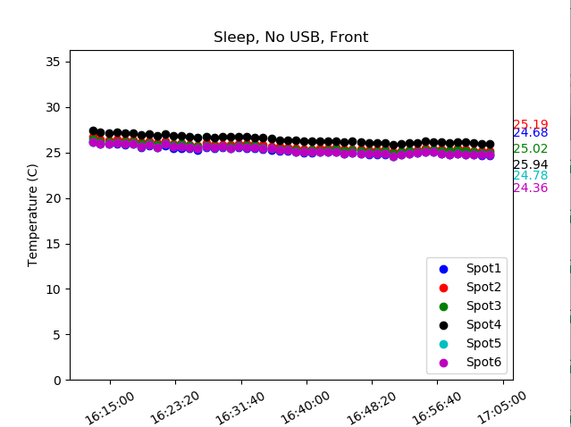
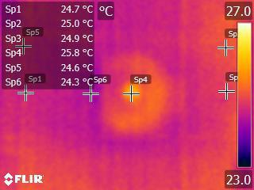
04/20/2018
Ambient Temp = 23C
Repeatable
Sp2
Sp3

Slide 6
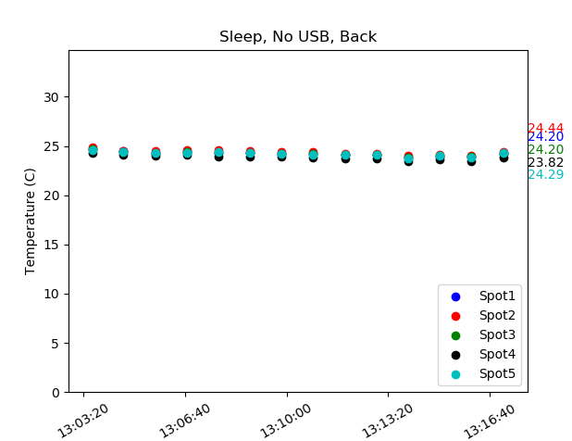
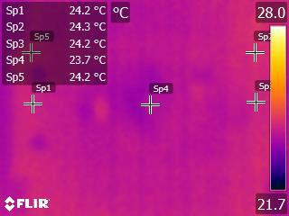
04/20/2018
Ambient Temp = 23C
Sp2
Sp3

Slide 7
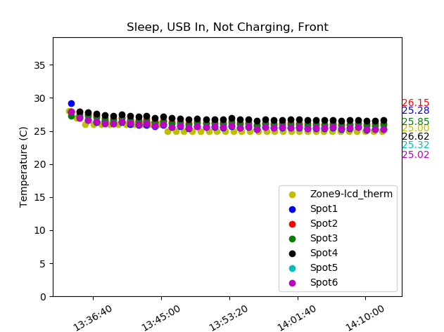
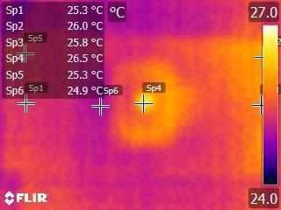
04/20/2018
Ambient Temp = 24C
The temp between “USB in, not charging” is similar to “USB not in”. The values here seem a little higher because the ambient temp is higher.
Sp2
Sp3

Slide 8
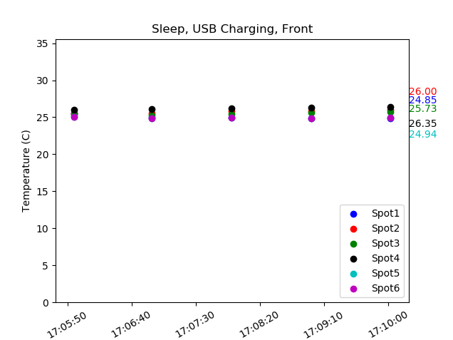
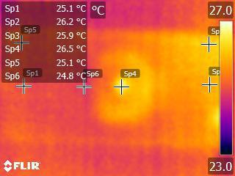
04/20/2018
Ambient Temp = 23C
Sp2
LEIA
Sp3

Slide 9
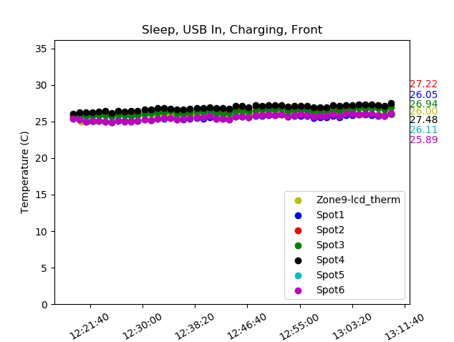
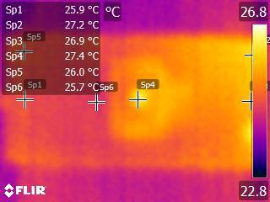
04/23/2018
Ambient Temp = 23C

Slide 10
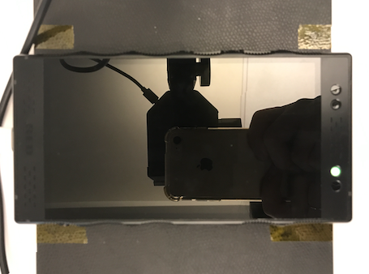
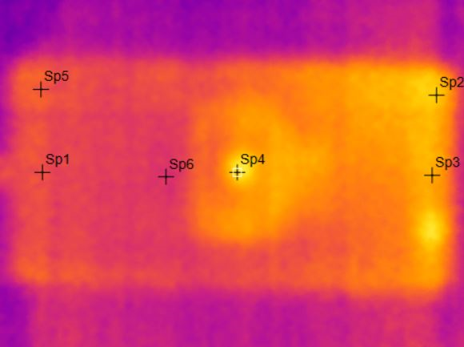
04/23/2018
Main Board
Green LED

Slide 11
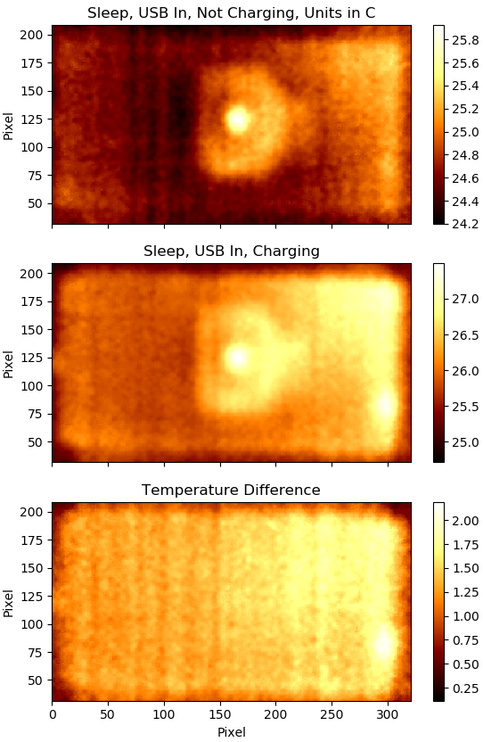
04/23/2018
Camera reflection. Can ignore.
Green LED. Can ignore.
USB Laptop Charging adds in 1C to 1.5C

Slide 12
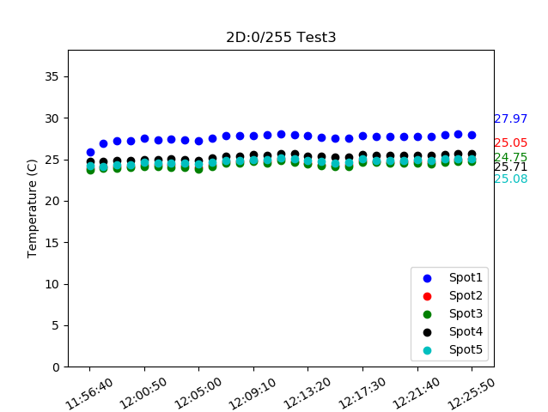
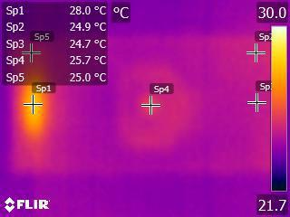
04/20/2018
Ambient Temp = 23C
No USB plugged in
Repeatable
Sp2
LEIA
Sp3

Slide 13
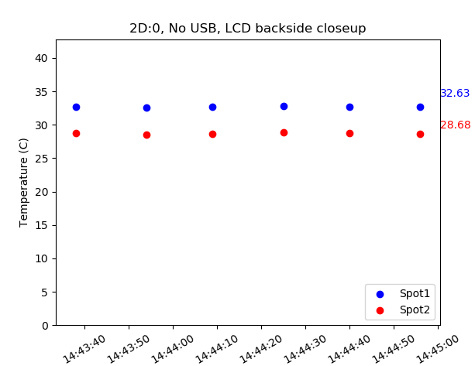
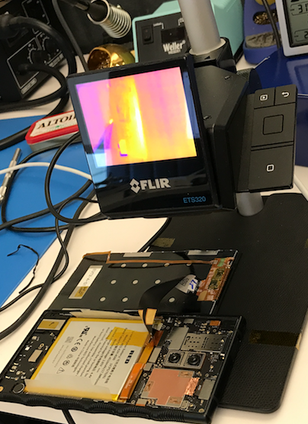
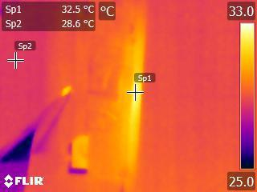
04/24/2018
Ambient Temp = 24C

Slide 14
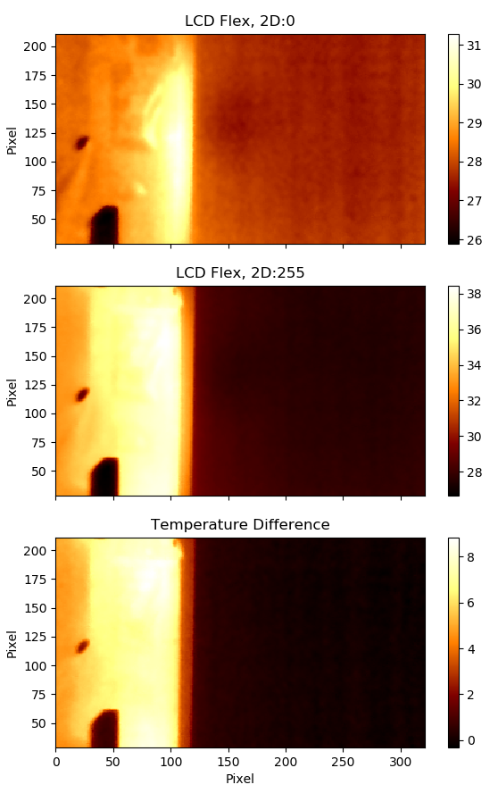
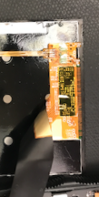
04/24/2018
Ambient Temp = 24C
Hot spot on LCD is 31.3C
Hot spot on LCD is 38.5C
Max Temp difference when 2D backlight turns on to 255: 8.8C

Slide 15
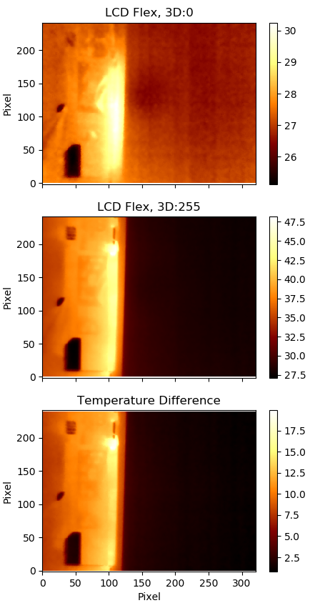
04/24/2018
Ambient Temp = 24C
Hot spot on LCD is 30C
Hot spot on LCD is 48.2C
Max temp difference when 3D backlight turns on to 255: 20C

Slide 16
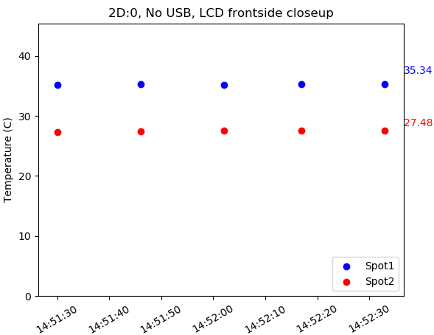
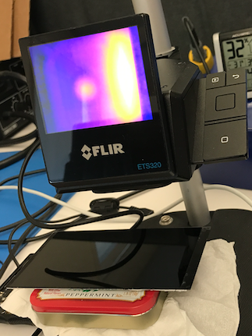
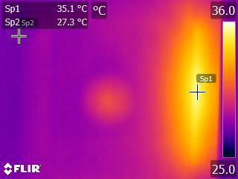
04/24/2018
Ambient Temp = 24C

Slide 17
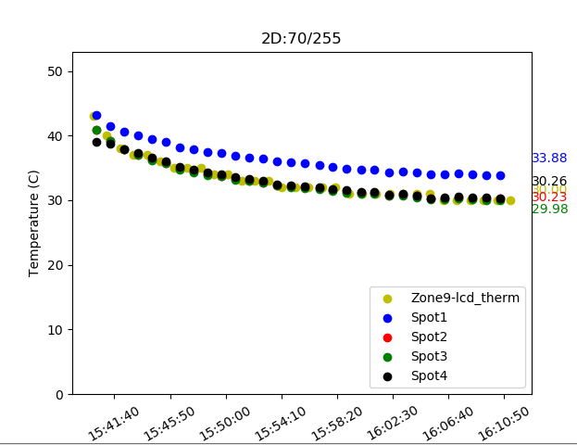
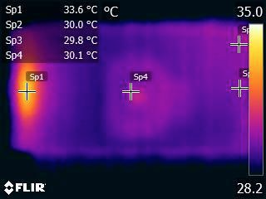
04/18/2018
Ambient Temp = 23C
LEIA

Slide 18
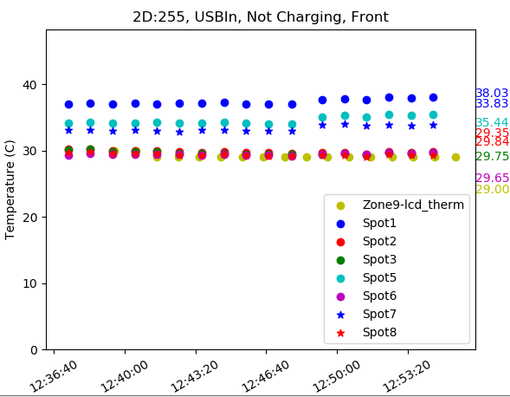
04/24/2018
Ambient Temp = 24C
Difference between white screen and black screen
Black screen measures 1degree C lower than white screen
Black screen
White screen
37.1
29.7
29.5
34.1
29.3
33.0
29.4
LEIA

Slide 19
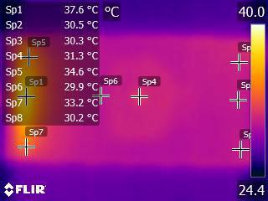
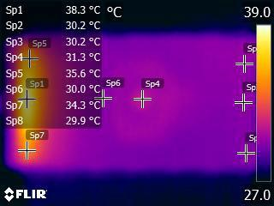
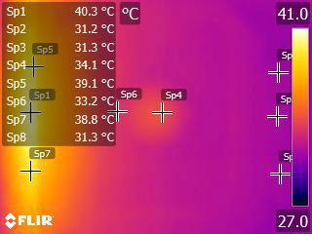
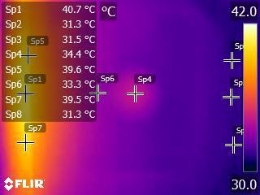
04/24/2018
Black screen
White screen
Ambient Temp = 24C
Difference between white screen and black screen
Black screen measures 1degree C lower than white screen
Close up
LEIA

Slide 20
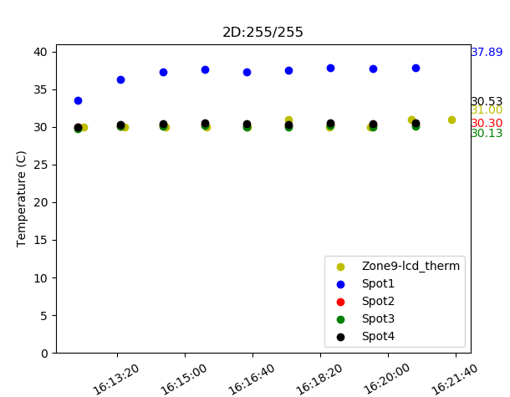
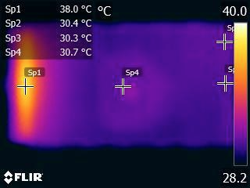
04/18/2018
Ambient Temp = 23C
Laptop charging
LEIA

Slide 21
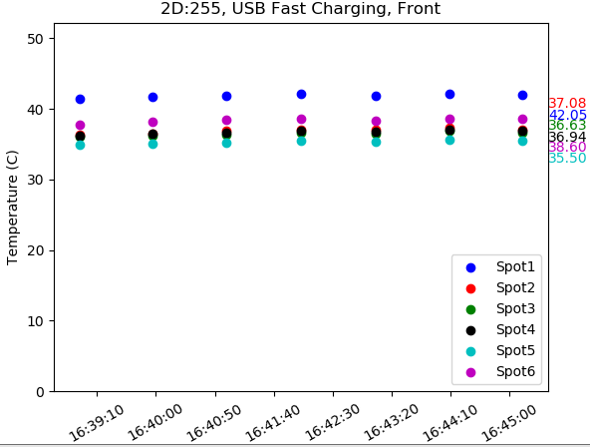
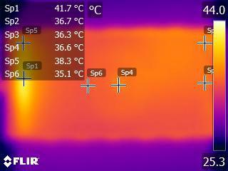
04/23/2018
Ambient Temp = 24C
LEIA

Slide 22
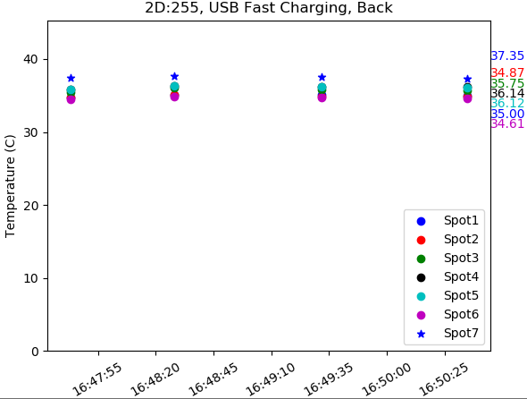
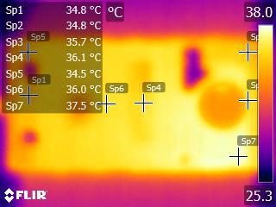
04/23/2018
Ambient Temp = 24C
LEIA

Slide 23
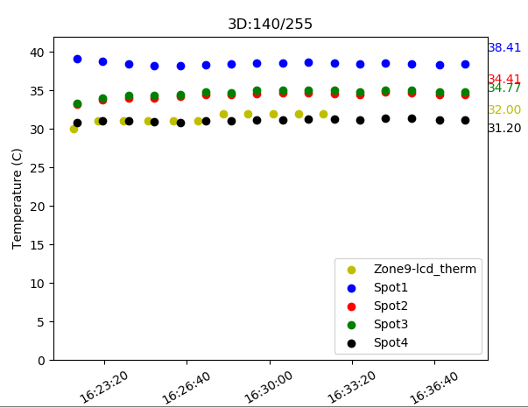
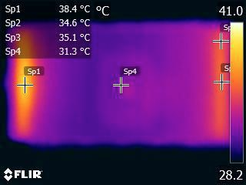
04/18/2018
Ambient Temp = 23C
LEIA

Slide 24
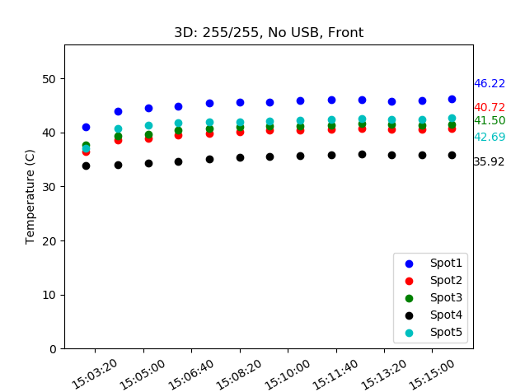
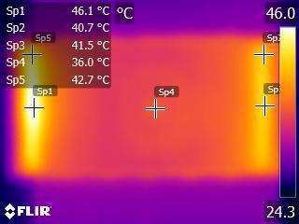
04/20/2018
Ambient Temp = 23C
Tape strip = 46
IR Gun = 43.1

Slide 25
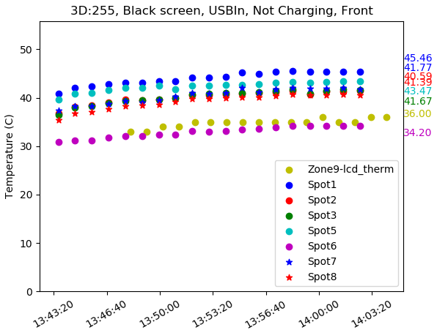
04/24/2018
Ambient Temp = 23C

Slide 26
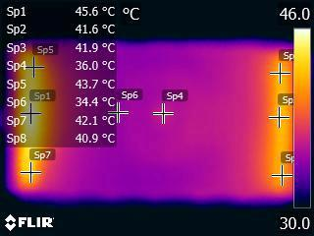
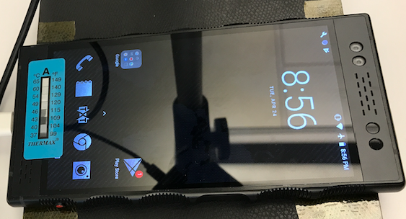
04/24/2018
Ambient Temp = 24C
Tape strip = 46C
IR Gun = 43.1C

Slide 27
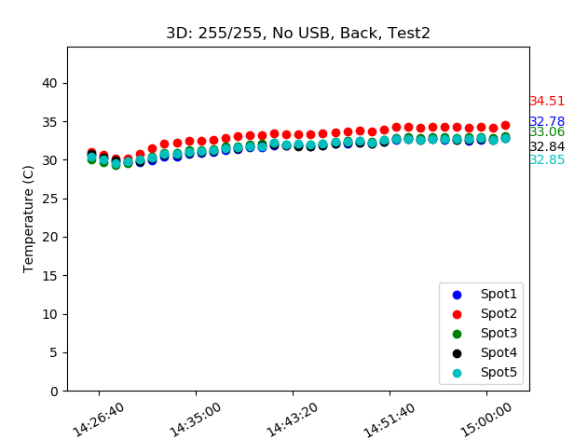
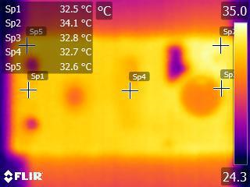
04/20/2018
Ambient Temp = 23C

Slide 28
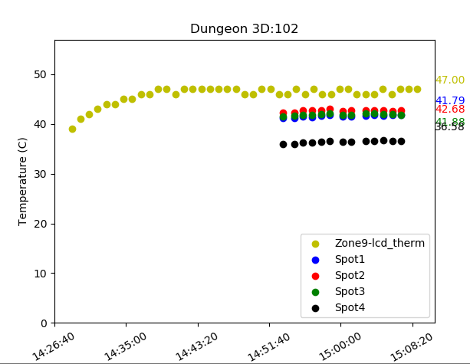
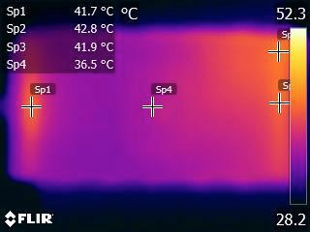
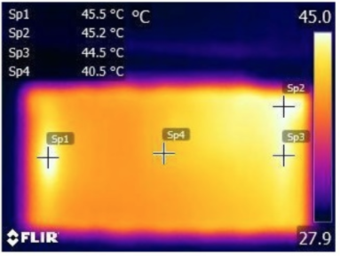
04/18/2018
Ambient Temp = 23C
14:31 - FPS 38-42
15:00 - FPS 30
LEIA
14:41 - FPS 27-29
Cloudminds

Slide 29
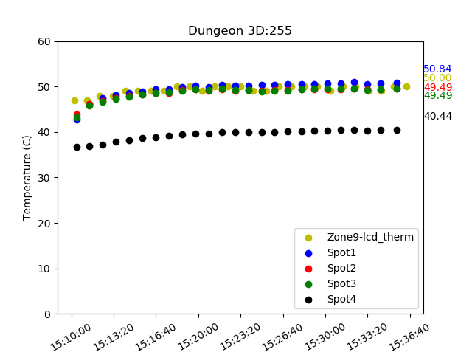


04/18/2018
Ambient Temp = 23C
15:12 - FPS 28-32
15:32 - FPS 22-25
LEIA
Cloudminds

Slide 30


04/25/2018
Ambient Temp = 23C

Slide 31


04/26/2018
Ambient Temp = 23C
Dungeon Masters, 4x1, ACT On, DOF On, Low GPU Freq = 180,000,000
FPS = 10

Slide 32


04/26/2018
Ambient Temp = 23C
Dungeon Masters, 4x1, ACT On, DOF On, High GPU Freq = 710,000,000
FPS = 35

Slide 33

04/23/2018
Ambient Temp = 23C

Slide 34


04/26/2018
Ambient Temp = 23C

Slide 35


04/26/2018
Ambient Temp = 23C

Slide 36
NOTES

Slide 37


04/18/2018
Ambient Temp = 23C
USB plugged in
Sp2
LEIA
Sp3

Slide 38
Camera reflection - rectangle with bright center

Slide 39


04/18/2018
Ambient Temp = 24C
Front is hotter than back

Slide 40


04/18/2018
Ambient Temp = 24C

